Slide 1

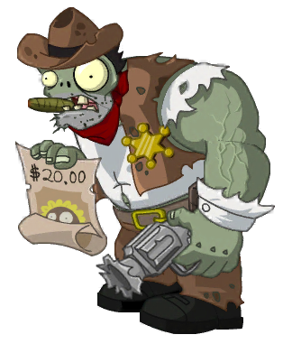
Zombie Apocalypse
You were infected by an undead but somehow when you turned into a zombie, you still kept your mind. Now, you are on a mission to destroy all the evil undead whose goal is total world domination.
There are only 200 of us left :(

Slide 2
Objects
- Player
- Zombie
- Weapons
- Map
- Scoreboard

Slide 3
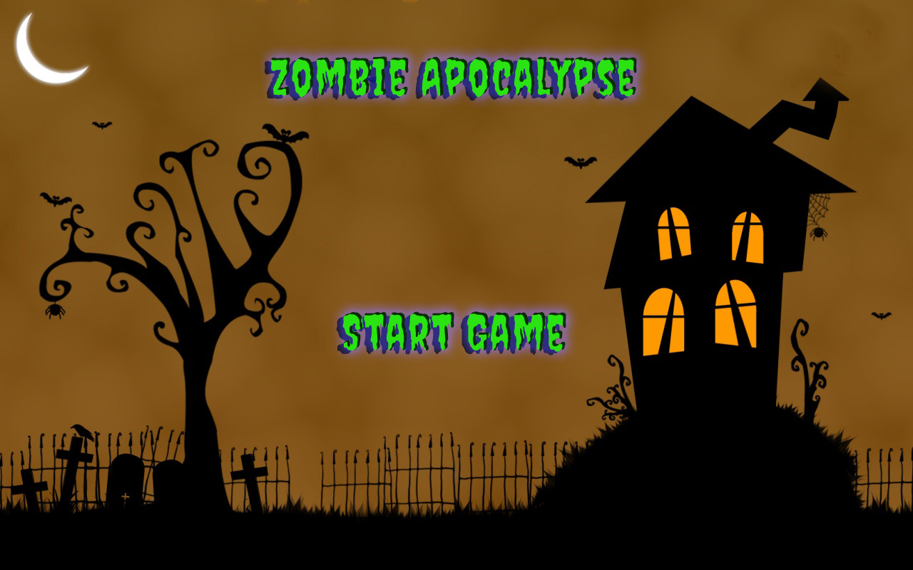

Slide 4
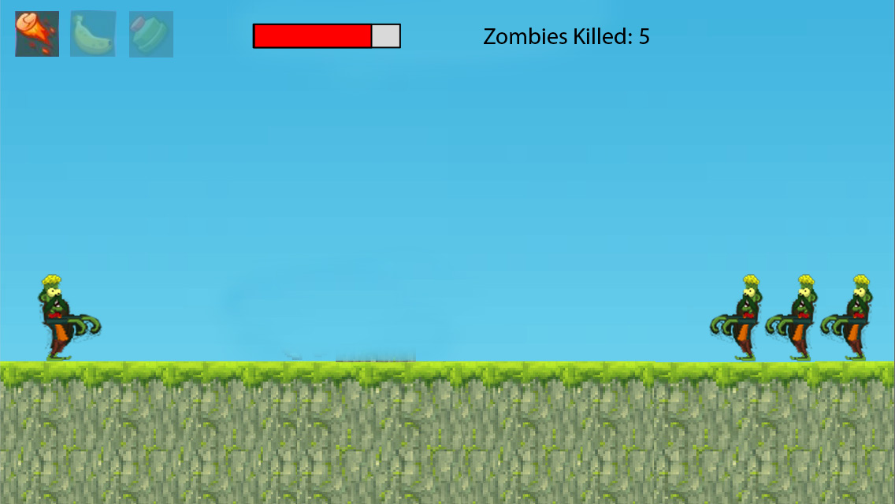

Slide 5
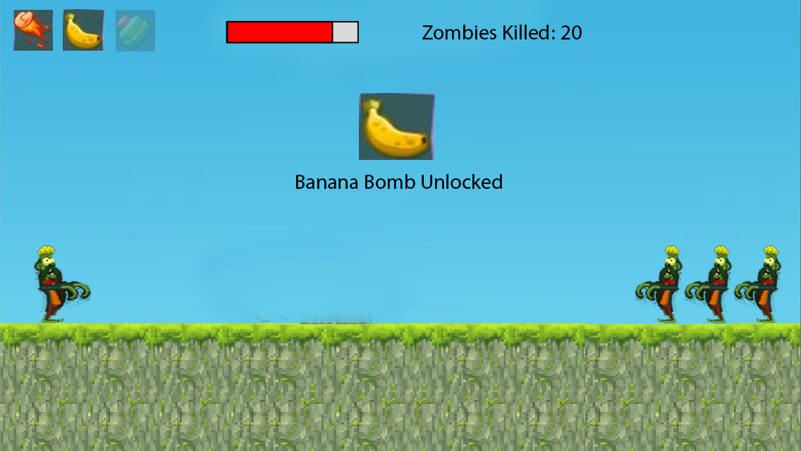

Slide 6
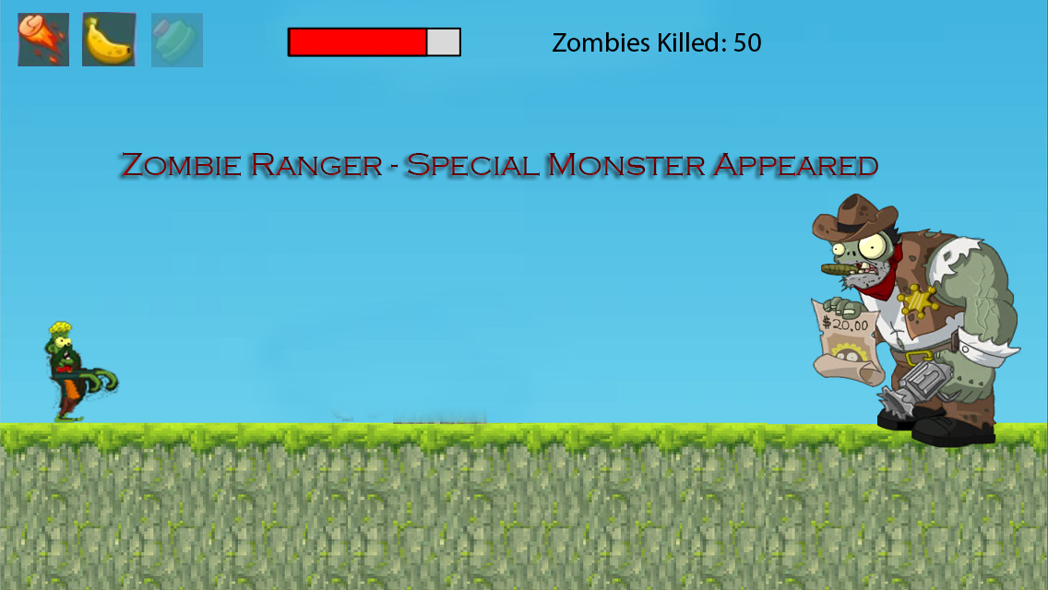

Slide 7
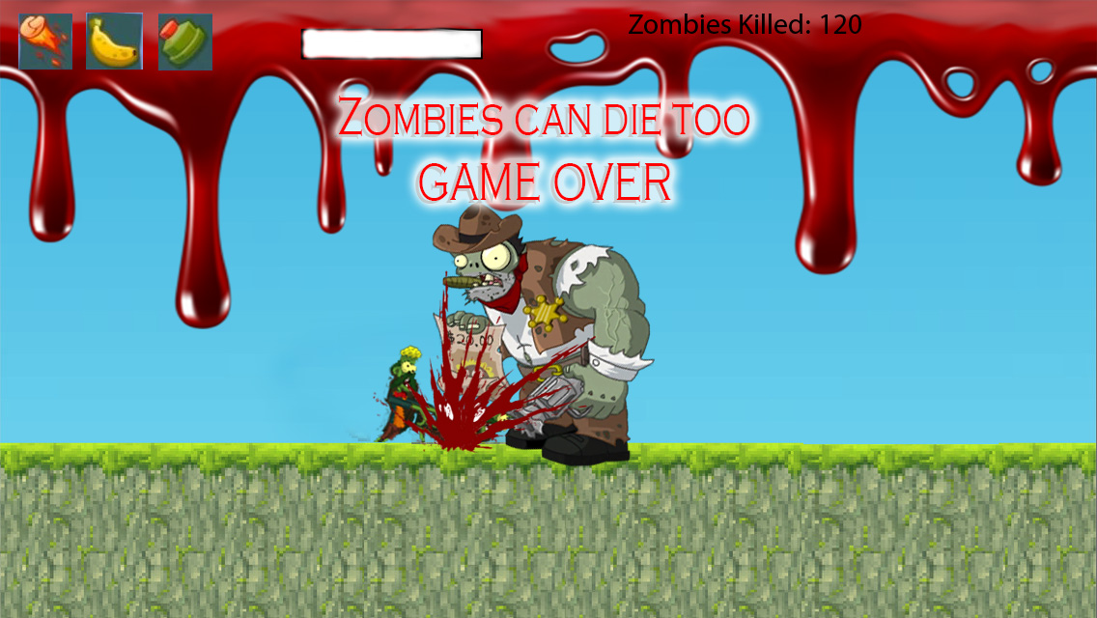

Slide 8
